Slide 1
Parent Discussion Group 2019: “Why Do They Act That Way?” by David Walsh, Ph.D.
Heidi Holton, M.Ed.
Wichita Collegiate School
Middle School Counselor

Slide 2
Welcome!
Introductions
Parents:
Name
Student – gender / grade
What brought you to this discussion?
Is there any topic you are interested in discussing and why?
Counselor
Share purpose behind discussion.
Discuss the material as it relates to helping our teens through adolescence. Additional material may be provided to help facilitate discussion.
Place for parents to hear from Author, Counselor, AND one another!

Slide 3
A Note from Heidi:
Self-Check In:
How are you doing with the beginning of the school year?
Recognize that parenting and working with your teen in their adolescent years can be challenging.
Glass analogy
Is your glass full? Half-empty? Needs refilling?
Find ways to “fill your glass/bucket” in order to pour love and compassion on your teen.
This Photo by Unknown Author is licensed under CC BY-SA

Slide 4
Chapter 1: Making Sense of Adolescence
Describing adolescence: “begins at puberty and ends…sometime!” (p 2)
Kevin → “gone from happy to sullen, talkative to quite, easygoing to hostile.” (3)
Adolescence can look a lot like the “terrible twos” (6)
Parent Survival Kit (Appreciating Adolescents)
Thoughts? Helpful?
Story of Mary and the “Iceberg Theory”
Behavior and emotions presented often don’t show the ENTRIE picture.
“I think beneath the tough stuff, you’re really hurting and scared.” (p. 10)
Response on p.11 → used “shutting down/out” as coping strategy.
Significance of this? How did this question allow Mary to open up?
How does this relate to our teens?

Slide 5
Chapter 1: Making Sense of Adolescence
David Walsh stresses 3 IMPORTANT parts of parenting:
Connection, Guidance, and Love
Nature AND Nurture → So, what about the BRAIN?
It can seem to teens that parts of their brain are doing “somersaults” and they can be equally as confused as adults in any given situation. It is NECESSARY to take a step back and evaluate what is actually happening at that moment. (p. 11)
Brains are growing and maturing during the adolescent ages. Yet, teens also have to grapple with the idea of wanting to be an adult, but not quite yet.
Story of Timmy
Completely different kid at home, uninvolved/attached
Tells his teachers that he would buy his parents a new house because he “loved them that much” (p. 17)
Remember, kids are kids! Behavior does not dictate who they are or question how much they care for you.

Slide 6
Chapter 1: Making Sense of Adolescence
What’s your parenting style? (pg. 22)
How our parenting affects our relationship with our teens.
Guided thoughts / questions:
1. Become aware of what you need to change.
2. Consciously choose how you want to act.
3. Repeat until it feels comfortable
Think about this, is there anything you want to continue or change?
Do’s and Donts on pg. 24/25

Slide 7
Chapter 2: A Guided Tour of Their Brains
The brain is a complex organ and ELECTRICAL system. (p 27)
Terms: David Walsh refers to the BRAIN when describing the organ itself and the MIND when describing what the brain does.
“The crucial role of experience in the brain is summed up in: the neurons that fire together, wire together.” People, especially teens are shaped by their experiences.
LIMBIC SYSTEM VS PRE-FRONTAL CORTEX
Limbic system is the “seat of emotion” – containing the:
Amygdala - fight, flight, freeze
Hippocampus – memory
Hypothalamus – hormones
VS circuit (ventral striatal – motivation
Pre-frontal Cortex
Logic and reasoning, planning, personality, Higher cognitive/complex thinking

Slide 8
Chapter 2: A Guided Tour of Their Brains
Five Pillars: (pg. 37)
1. Use it or lose it
2. Blossoming and pruning
3. The window of opportunity
4. The window of sensitivity
5. Myelination
Why do we talk about the brain in teens?
It can seem as though their behavior is bad parenting or environmental, but it can actually be their biological changes! Knowing about the brain gives us more info to support our teens.
Parent survival kit (pg 38)
Thoughts?

Slide 9
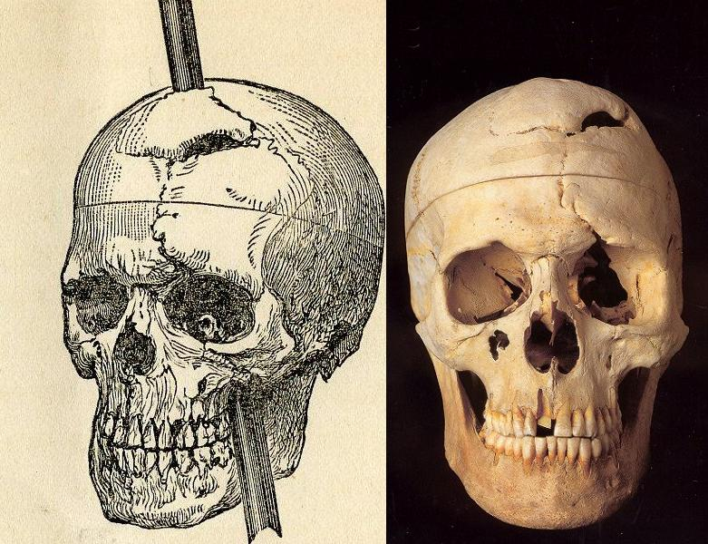
Chapter 3: Why Adolescents are so Impulsive
Phineas Gage example and the effects of Trauma on PFX
Accident in his PFX completely changed his brain chemistry and demeanor
Blossoming and Pruning Process
Not yet fully developed in the teen years
Processing points with your teen:
1. When it’s time for you to enforce a consequence, take a minute and visualize how you want to handle it. Picture yourself as calm and firm.
2. Tell him that it was his choice that is causing the consequence. Don’t expect him to take this message calmly. He may try to talk his way out of it or may want to argue. Don’t join in on the argument.
3. If you feel your blood pressure rising, take a deep breath and remember this advice: “When you feel like taking the wind out of his sails, it is a better idea to take your sails out of the wind.” (page 47)
This Photo by Unknown Author is licensed under CC BY-NC-ND

Slide 10
Chapter 3: Why Adolescents are so Impulsive
Parent Survival Kits:
Limits and consequences (pg. 48)
Behavior contract example (pg. 51)
Set clear rules and expectations for behavior.
Have calm conversations about expectations, when they are met and unmet.
Have your child communicate what is expected.
Follow through with expectations and consequences.
Take breaks if necessary, revisit

